Slide 1
Challenges and Opportunities
Janani Ramanathan
Associate Fellow, World Academy of Art and Science
Research Associate, Mother’s Service Society
Individual Accomplishment, Growth & the Character of Life
in Management, History, Literature, and Psychology

Slide 2
Challenges and Opportunities
Opportunities that arise from Challenges
Individual Accomplishment, Growth & the Character of Life in Management, History, Literature, and Psychology

Slide 3
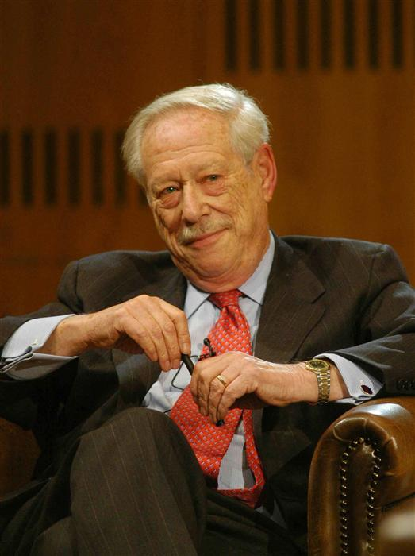
Challenges and Opportunities
Challenges Change Attitudes
Michael Blumenthal
Individual Accomplishment, Growth & the Character of Life in Management, History, Literature, and Psychology

Slide 4
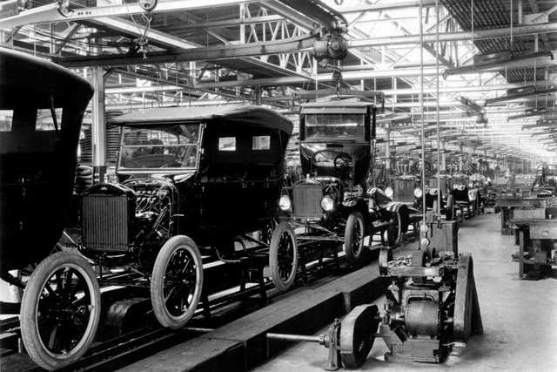
Challenges and Opportunities
New situations break resistances
Individual Accomplishment, Growth & the Character of Life in Management, History, Literature, and Psychology

Slide 5
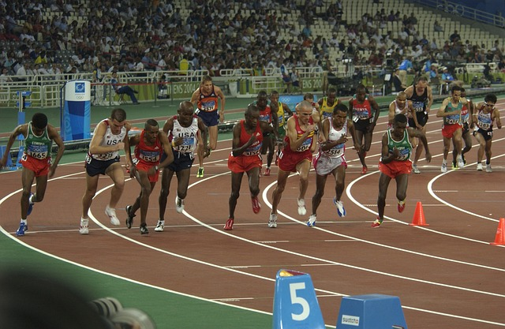
Challenges and Opportunities
What differentiates those who tide over a crisis from those who succumb to it?
Individual Accomplishment, Growth & the Character of Life in Management, History, Literature, and Psychology

Slide 6
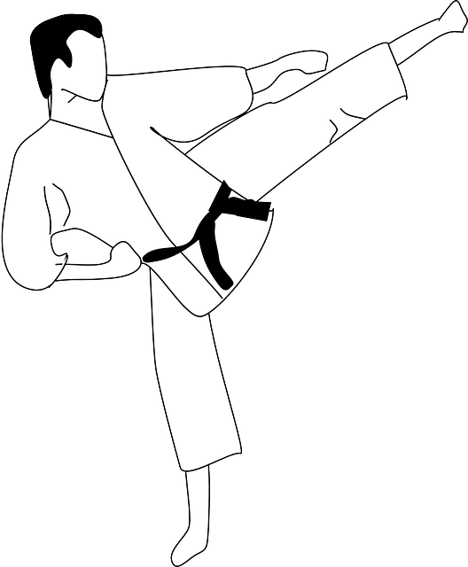
Challenges and Opportunities
Redirect the Energy
Individual Accomplishment, Growth & the Character of Life in Management, History, Literature, and Psychology

Slide 7
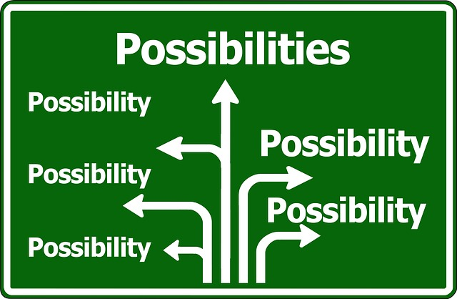
Challenges and Opportunities
Look out for the Opportunity
Individual Accomplishment, Growth & the Character of Life in Management, History, Literature, and Psychology

Slide 8
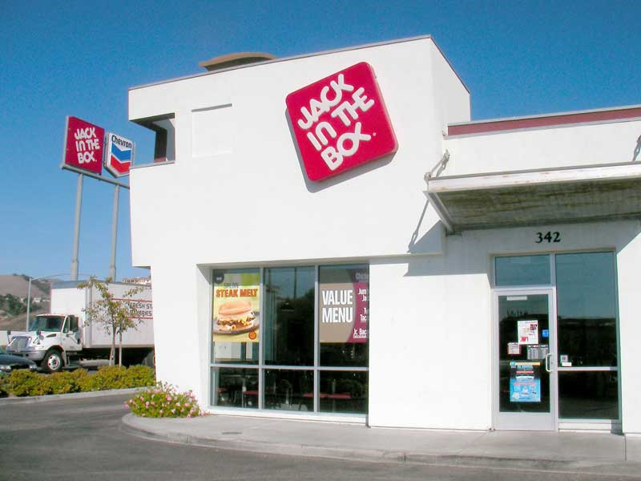
Challenges and Opportunities
Learn from Mistakes
Individual Accomplishment, Growth & the Character of Life in Management, History, Literature, and Psychology

Slide 9
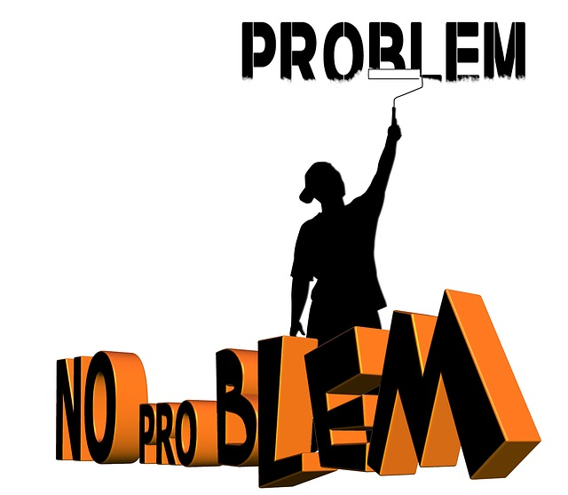
Challenges and Opportunities
Think Creatively and Adapt
Individual Accomplishment, Growth & the Character of Life in Management, History, Literature, and Psychology

Slide 10
Challenges and Opportunities
Often, it is the greatest challenges that lead to the greatest human achievements
Our response determines the results
What is the difference between challenges and opportunities?
Is it possible that all challenges have concealed opportunities behind them?
Individual Accomplishment, Growth & the Character of Life in Management, History, Literature, and Psychology

